Slide 1
Amazon Shopper Purchasing Intentions
Shola & the Ben’s

Slide 2


Business Understanding
By analyzing the online shoppers data we can assist Amazon in establishing a proper strategic goal for the future in order to increase the amount of browsing sessions that will end in a purchase.
Notes:
For an international conglomerate such as Amazon, turning page visits and mouse-clicks into purchases is a vital business process. From the layout of the website’s user interface, to the selection of items to be placed on sale, honing in and fine-tuning the shopping experience to nudge the customer to purchase an item in their shopping cart or wish list is an indelible aspect of the constant need to adapt and improve. Also we have targeted for data collection and tracking will reveal which area of website user interface optimization should be focused upon moving forward to provide more purchase conversions from page views.

Slide 3
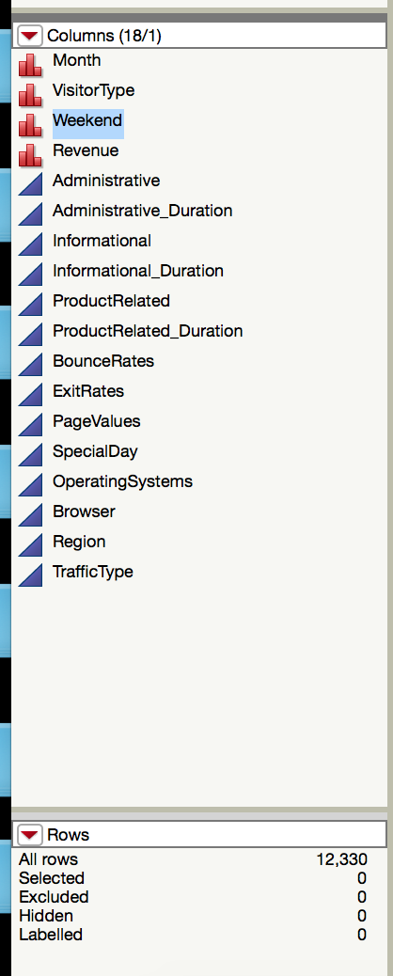
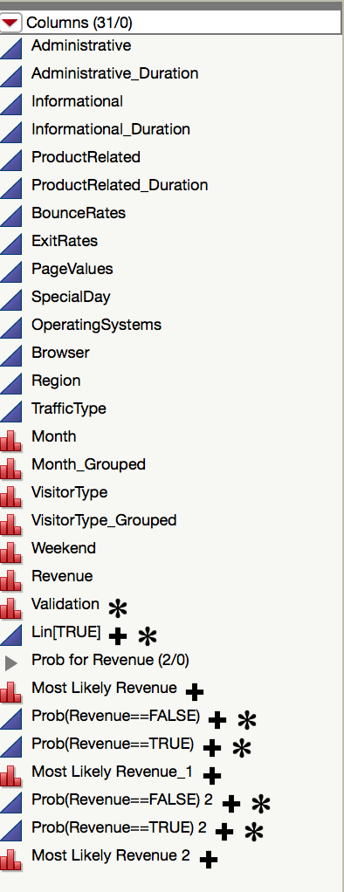
Data Understanding
12,330 rows
18 Columns
4 Numeric variables
14 Continuous variables
Notes:
Picture on the left is original, Picture on the right is data set after modeling

Slide 4

Data Preparation
First we removed ‘Page_Values’ because it was creating Target Leakage
Then we grouped months in accordance with Amazon's quarterly sale schedule
Lastly for the data preprocessing we grouped “other” values from ‘Visitor_Type’ with “returning customers” values.

Slide 5
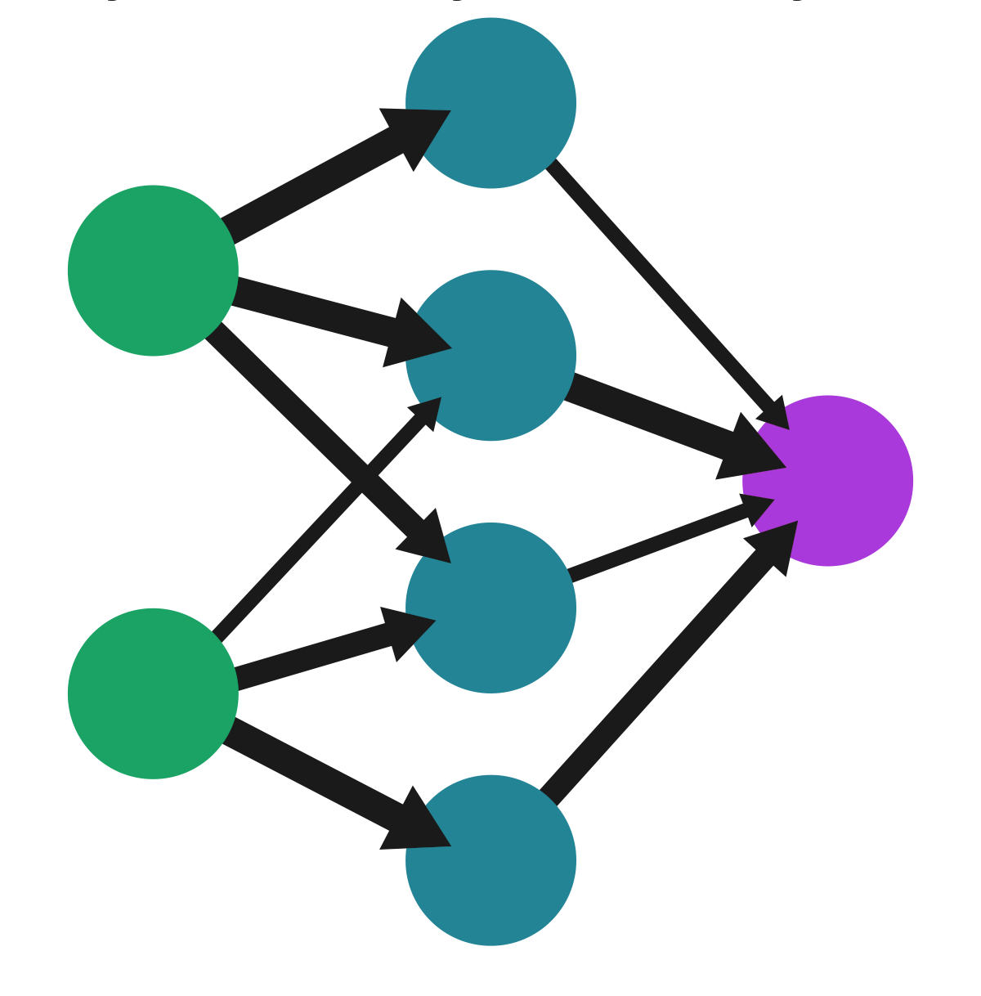
Methodology
Focused on categorical models
Model Analysis Performed:
Nominal Logistic Regression
Penalized Regression
Ridge vs. Lasso methods
Classification & Regression Ensemble
Decision Tree, Bootstrap Forest, & Boosted Tree
Neural Models
Multiple attempts of varying complexity

Slide 6

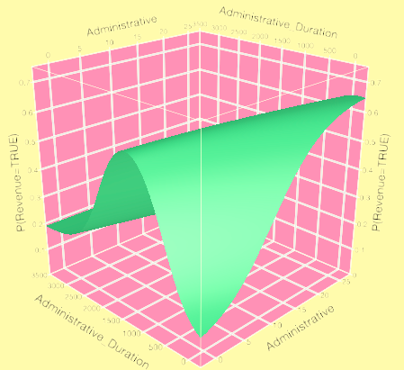
Best Model Comparison
Compared similar models to narrow down the ‘best of the best’
Fit Nominal Logistic
Penalized Regression: Lasso
Classification & Regression Ensemble: Bootstrap Forest
Neural Models: 3 nodes, 0 hidden layers using the sigmoid activation function
AUC Values
Boosted Tree | 0.7557
Bootstrap Forest | 0.7564 | Total Diff
Partition | 0.7265 | 3.95%
AUC Values
Logistic Regression | 0.734
Ridge | 0.7347 | Total Diff
Lasso | 0.7358 | 0.24%

Slide 7
Final Model
Determined two models outperformed the rest based on AUC, standard error, as well as context for the data being analyzed:
Explanatory purposes: Fit Nominal Logistic
Data captured purposes: Bootstrap Forest
Both give us valuable insight into the ‘well-known’ data regarding purchase process, as well as illuminating new areas that could be beneficial for predictive purposes

Slide 8

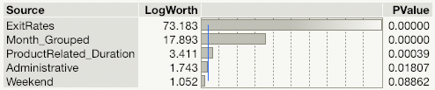
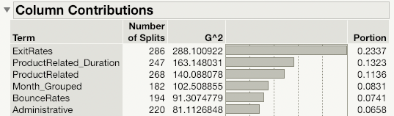
Final Model: Insights
Bootstrap Forest
Attributes Highlighted
ExitRates
ProductRelated
Months
Fit Nominal Logistic
Attributes Highlighted
Exit Rates
Month
ProductRelated
Both of our best models concur with one another that these are our best predictors
This indicates:
Current data viability
Adding more data would result in more accurate results and strengthen our models performance

Slide 10

Recommendations
Increase customer engagement around non-traditional retail holidays.
Work to increase compatibility across browser systems.
Create a singular landing page for new customers.
Notes:
For this analysis, we have concluded that the best ways of implementing the knowledge from this data analysis would be to…
1 Increase customer engagement around non-traditional retail holidays.
2 Work to increase compatibility across browser systems, as there is downward pressure on the probability of a purchase depending on which browser is being utilized (ahem: Internet Explorer…)
3 Create a singular landing page for new customers who are redirected to the website, welcoming the customer, while also requiring a click to continue to the original page of interest.

Slide 11
Questions?

